Slide 1
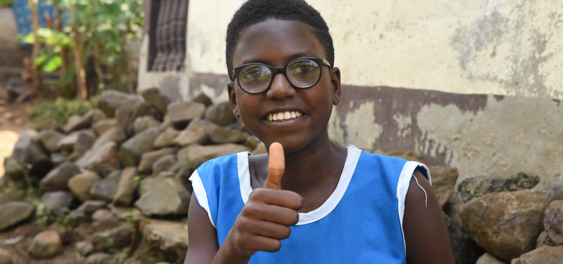
Five (potential) hurdles to participation
… and how to overcome them!
© CBM

Slide 2
Hurdle No 1: “The concerns of persons with disabilities only affect a few within society.”

Slide 3
Really?
1,3 million persons with disabilities live worldwide, which is equivalent to 16% of the world’s population.
It also means that one in six persons has a disability.
Consequently, persons with disabilities are one of the largest minority group worldwide.
There is a strong causality between poverty and disability. Living in poverty more likely leads to a disability and vice versa.

Slide 4
Hurdle No 2: “Participation of persons with disabilities is expensive.”

Slide 5
Don‘t think short term!
The exclusion of persons with disabilities affects the overall effectiveness, sustainability and quality of international cooperation and ultimately leads to inefficiently used funds.
Neglecting participation means renouncing good planning and ownership of the target groups, which can ultimately only lead to the failure to achieve your goals. Is that inexpensive?
One example: A recent WHO study shows that for every 1 US Dollar you spent on disability-inclusive prevention and care of noncommunicable diseases, governments could expect a return of 10 US Dollars.

Slide 6
Hurdle No 3: “There are so many requirements to ensure accessibility.”

Slide 7
Oh please!
If you want different perspectives present, they come with different needs.
You can start with some requirements and make them standards. Then you add more. You will find it easier to improve once you started.
Check the material CBM provided within the Inclusive Participation Toolbox like checklists for meetings and event venues to help you navigate.

Slide 8
Hurdle No 4: “Our project is not directly related to disability.”

Slide 9
We are sure it is…
As long as it affects people, it will also be affecting persons with disabilities. If you are working e.g. in the health, education, disaster risk reduction, social or livelihood sector, you want any project to reach everybody in the relevant community, right? This means, persons with disabilities are always a target group.
If you are aiming at reducing poverty worldwide, persons with disabilities will for sure be among your target group as there is a strong link between disability and poverty.
Developing accessible and disability-inclusive projects lead to better inclusion of all marginalised groups and benefit everyone.

Slide 10
Hurdle No 5: “I am afraid of doing something wrong or being insensitive.”

Slide 11
Allow yourself to grow
Start with working on the way you talk with or about persons with disabilities. This knowledge will give you more confidence and help you engage with persons with disabilities. Abandon any formulations around pity but talk human rights based.
Learn some ground rules about disability-sensitive behaviour, e.g. when it comes to interacting with persons with different disabilities or about assistive devices.
You don’t have to be an expert from day 1. Educate yourself and allow yourself to grow over time and experience.

Slide 12
Contact
Resource provided by
© CBM Christoffel-Blindenmission Christian Blind Mission e.V.
Inclusive Participation Toolbox
https://participation.cbm.org
participation@cbm.org
January 2023

